Slide 1
Balanced scorecard slide 1
ASSET MANAGEMENT
POLICY

Slide 2
Balanced scorecard slide 2
KEY CONSIDERATIONS
A good policy needs to be consistent with the organization’s goals and aspirations for the future, while being prepared to respond to the demands of today.
FINANCIAL PERSPECTIVE
PEOPLE PERSPECTIVE
Supports Financial Sustainability.
Helps protect and enhance the quality of life for people in your community by ensuring the best possible decisions regarding your assets.
Supports evidence-based business cases for budgets and long-term financial forecast and planning.
Drives longer term thinking and planning.
INTERNAL PROCESS PERSPECTIVE
GROWTH PERSPECTIVE

Slide 3
Balanced scorecard slide 3
ASSET MANAGEMENT POLICY
FINANCIAL PERSPECTIVE
One of the key considerations of asset management policy development is Lifecycle Costing. Lifecycle costing includes:
Construction
Corrective Maintenance
Operating Costs
Inspections
Preventative Maintenance
80%
20%
Lifecycle Costs
Upfront Costs
(construction/rehab/disposal)

Slide 4
Balanced scorecard slide 4
ASSET MANAGEMENT POLICY
GOVERNANCE PERSPECTIVE
Service Provision
Delivery resources
How it gets done
Asset Management
What needs to be done
When and where
Asset Governance
Stakeholder interface & corporate direction
Why things need to be done.
Customer/Stakeholders
How is the service received
Does the service meet the needs.

Slide 5
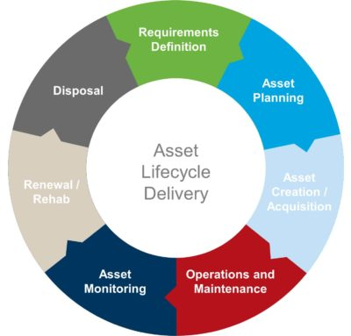
Balanced scorecard slide 6
ASSET MANAGEMENT POLICY
INTERNAL PROCESS PERSPECTIVE
AM Policy and Strategy
Financial and Funding Strategies
Define Levels of Service
Capital Works Strategies
Service Delivery
Forecast Future Demand
Maintenance Strategies
Assess Asset Condition
Operational Strategies
Understand Asset Base
Asset Management includes a broad range of people and departments within the organization. Your Asset Management Policy needs to reflect the various roles of those actors.

Slide 6
Balanced scorecard slide 2
POLICY COMPONENTS
A good policy needs to be consistent with the organization’s goals and aspirations for the future, while being prepared to respond to the demands of today.
Service Provision
Delivery Resources
HOW it gets done.

Slide 7
Balanced scorecard slide 2
POLICY COMPONENTS
A good policy needs to be consistent with the organization’s goals and aspirations for the future, while being prepared to respond to the demands of today.
SERVICE PROVISION
Delivery Resources
HOW it gets done.
WHAT needs to be done
WHERE and WHEN.
ASSET MANAGEMENT

Slide 8
Balanced scorecard slide 2
POLICY COMPONENTS
A good policy needs to be consistent with the organization’s goals and aspirations for the future, while being prepared to respond to the demands of today.
SERVICE PROVISION
Delivery Resources
HOW it gets done.
WHAT needs to be done
WHERE and WHEN.
Stakeholder & Corporate Direction
WHY things need to be done
ASSET MANAGEMENT
ASSET GOVERNANCE

Slide 9
Balanced scorecard slide 2
POLICY COMPONENTS
A good policy needs to be consistent with the organization’s goals and aspirations for the future, while being prepared to respond to the demands of today.
SERVICE PROVISION
CUSTOMER PERSPECTIVE
Delivery Resources
HOW it gets done.
HOW the service is received
Does the service MEET THE NEEDS
WHAT needs to be done
WHERE and WHEN.
Stakeholder & Corporate Direction
WHY things need to be done
ASSET MANAGEMENT
ASSET GOVERNANCE

Slide 10
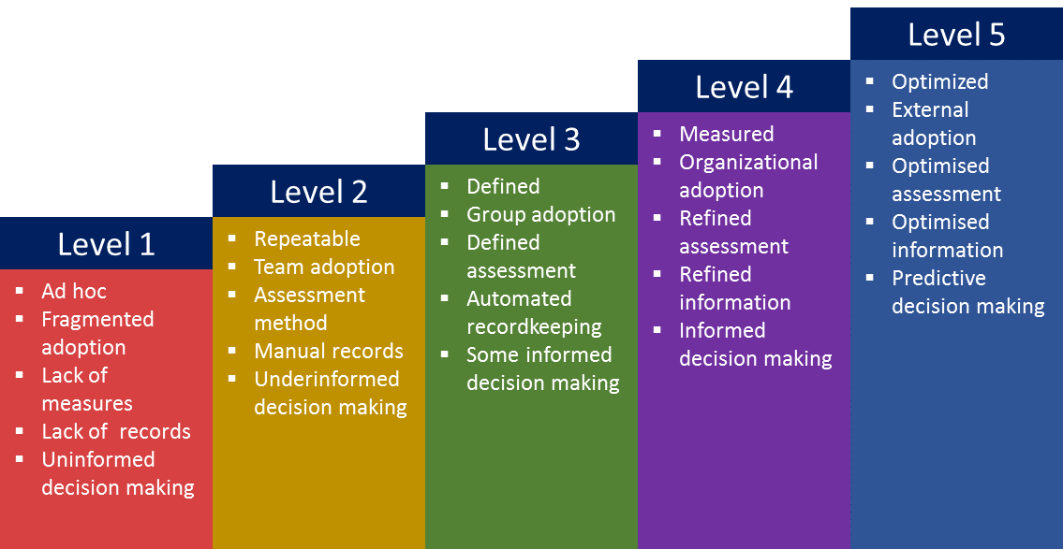
Balanced scorecard slide 7
ASSET MANAGEMENT POLICY
& STRATEGIC DIRECTION
Defines Where you are Going
Sets out the Key Principles and Goals that will Guide your Mission
Outlines your Vision of Success and How Progress Will be Measured

Slide 11
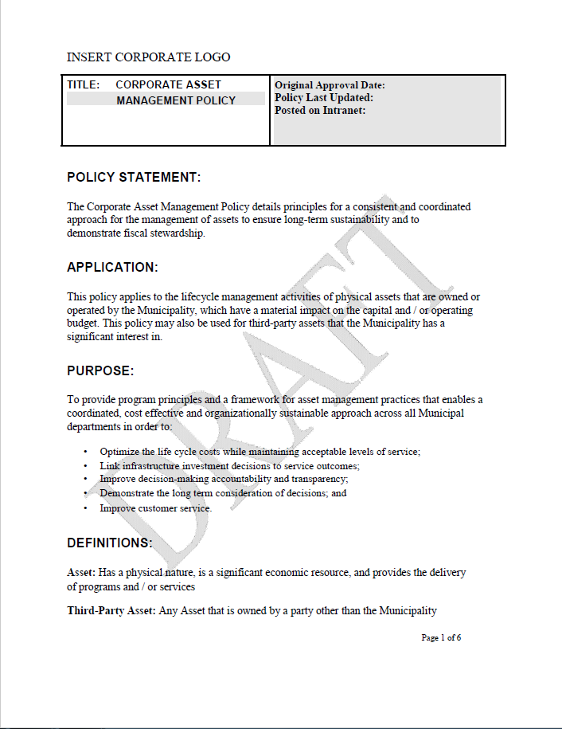
Balanced scorecard slide 7
ASSET MANAGEMENT POLICY
SECTIONS OF THE POLICY
TERMS AND DEFINITIONS: Key definitions for use within the asset management policy
BACKGROUND: A brief introduction to the history of corporate asset management program and policy
POLICY STATEMENT: A brief description of what the policy includes

Slide 12
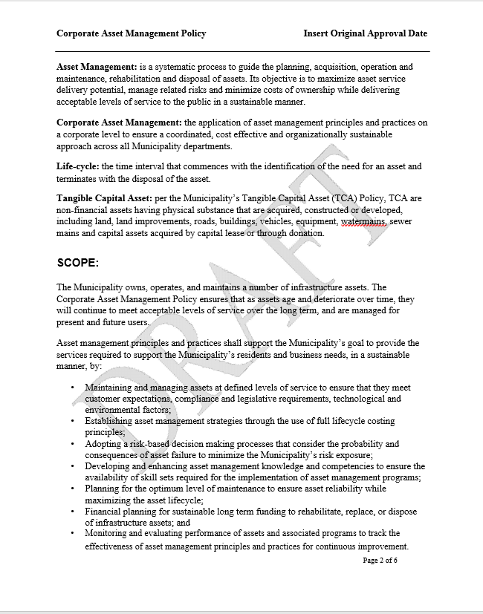
Balanced scorecard slide 7
ASSET MANAGEMENT POLICY
SECTIONS OF THE POLICY
SCOPE of the ASSET MANAGEMENT SYSTEM: A definition of the components, scope and documents within the asset management system.
ASSET MANAGEMENT MISSION, GOALS and PRINCIPLES: Key goals and guiding principles of the asset management program. The asset management mission statement, and the key asset management goals.
REVIEW PERIOD: The frequency of update of the asset management policy.

Slide 13
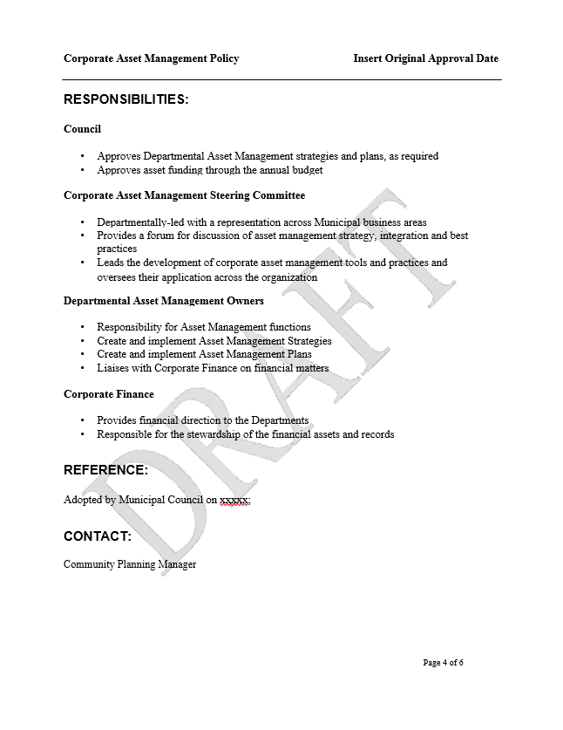
Balanced scorecard slide 7
ASSET MANAGEMENT POLICY
SECTIONS OF THE POLICY
ROLES AND RESPONSIBILITIES: The roles and responsibilities of Council, the executive team, the corporate asset management team, and service area working groups/providers.
CONTACT INFORMATION: The contact details for inquiries and questions.

Slide 14
Balanced scorecard slide 7
ASSET MANAGEMENT POLICY
PROPOSED POLICY GOALS
Making the Best Possible Decisions about Assets
Based on a Clear Understanding of the Long-term View
Satisfactory Levels of Service
Managing
Risks
Optimizing Lifecycle Costs
Provide levels of service that meet expectations and ensure a high quality of life for the community through:
Defining levels of service in consultation with stakeholders
Evaluating and communicating the costs of providing service
Quantifying the impacts of decisions on service

Slide 15
Balanced scorecard slide 7
ASSET MANAGEMENT POLICY
PROPOSED POLICY GOALS
Making the Best Possible Decisions about Assets
Based on a Clear Understanding of the Long-term View
Satisfactory Levels of Service
Managing
Risks
Optimizing Lifecycle Costs
Managing Risks Through:
Understanding risk exposure
Establishing the organization’s risk appetite
Developing risk management strategies; and
Implementing appropriate conditions assessment, inspection, and performance evaluation strategies

Slide 16
Balanced scorecard slide 7
ASSET MANAGEMENT POLICY
PROPOSED POLICY GOALS
Making the Best Possible Decisions about Assets
Based on a Clear Understanding of the Long-term View
Satisfactory Levels of Service
Managing
Risks
Optimizing Lifecycle Costs
Demonstrating sustainable and full lifecycle planning through:
Quantifying and tracking the full lifecycle costs for assets;
Ensuring budgets are supported by asset management practices; and
Bridging the gape between capital and operational budgets

Slide 17
Balanced scorecard slide 7
ASSET MANAGEMENT POLICY
PROPOSED POLICY GOALS
Making the Best Possible Decisions about Assets
Based on a Clear Understanding of the Long-term View
Satisfactory Levels of Service
Managing
Risks
Optimizing Lifecycle Costs
Ensuring accountability, transparency and engagement through:
Documenting asset management business processes;
Publicizing asset management documents so that they are available to stakeholders; and
Developing stakeholder engagement strategies to ensure that internal and external stakeholders are able to participate and contribute to asset management initiatives.

Slide 18
Balanced scorecard slide 8
ASSET MANAGEMENT AND CAPITAL PLANNING
Asset Management and Capital Plans go hand in hand. Like your Official Community Plan informs the land development of your community, the AM plan informs the capital works.
Without an Asset Management Strategy and policy to inform your capital priorities, you are simply taking your best guess as to what you need.
Continuous feedback and review of the asset management policy is required to inform your 3, 5 and 10 year capital plans.
Capital planning is about maintaining and renewing existing infrastructure, as well as making investments in new infrastructure.

Slide 19
Balanced scorecard slide 5
ASSET MANAGEMENT POLICY
Capital Perspective
Age of Asset
Condition of Asset
Meets Needs
RANK
Roads/Trails
Water Pipes
Solid Waste
Fleet
Planning for future growth and not focusing solely on replacing your current assets is a key aspect of good policy. A tool like this can provide a method to simply rank projects and can be used to inform your capital planning.

Slide 20
Balanced scorecard slide 5
ASSET MANAGEMENT POLICY
Remember … Go Back to the Basics with your Policy
And Happy Asset Managing!
RANK
Making the Best Possible Decisions about Assets
Based on a Clear Understanding of the Long-term View
Satisfactory Levels of Service
Managing
Risks
Optimizing Lifecycle Costs

Slide 21
Balanced scorecard slide 10
THANK YOU

